Slide 1
BAVART
Creators: Bobby Frazette, Abhaya Pawar, Vanessa Otto, Adam Zamojski
Notes:
Vanessa….. GO!

Slide 2
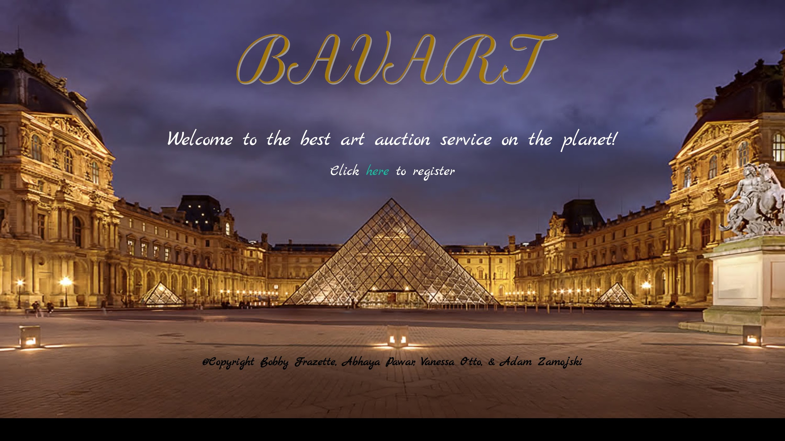
WHAT IS “BAVART”?
Notes:
BOBBY

Slide 3
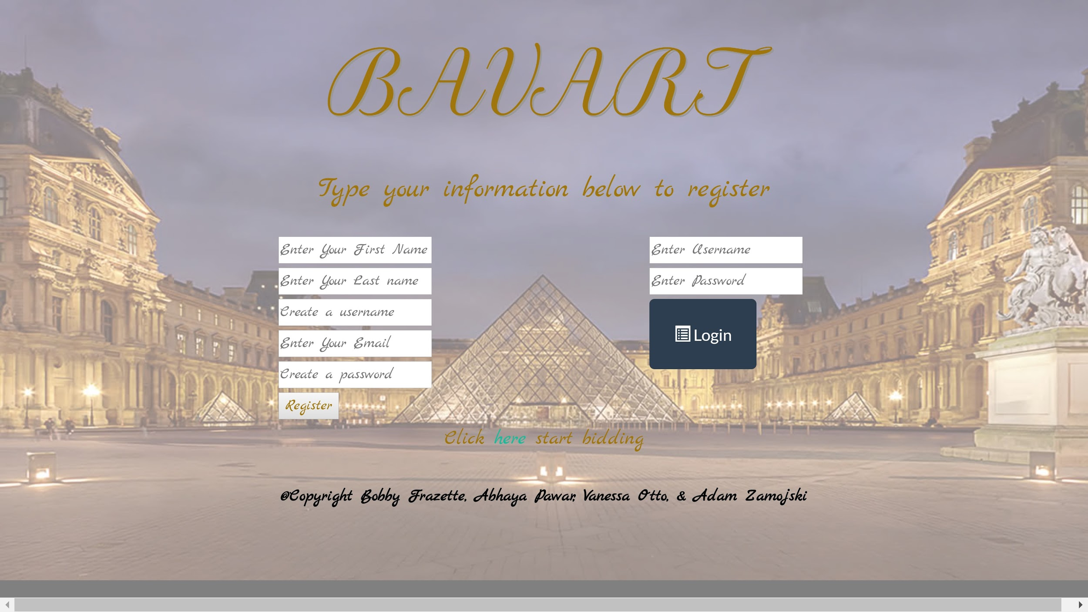
WHAT “BAVART” IS…(NOW)
BA VART noun :
An art auction website that allows users to post their artwork for sale
A very complicated
application built for
the Rutgers Coding
BootCamp class
3. Bobby
Abhaya
Vanessa
Adam
Rutgers
Team
Notes:
BOBBY

Slide 4
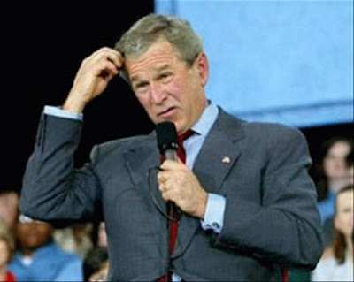
HOW DOES “BAVART” WORK?
After the user signs in, they can scroll through the available art up for auction and bid on the item of their choosing. When the time runs out on the item whoever the higher bidder is will be the new owner of the art piece.
Users can also add artwork of their own to be placed in the auction page of BAVART
Notes:
BOBBY

Slide 5
Let's see BAVART in action!!!
Notes:
ADAM

Slide 6

WHAT TECHNOLOGY DID WE IMPLEMENT?
Technology in the program itself:
HTML, CSS, Bootstrap, Google Fonts, JavaScript, JQuery, Sequelize, Handlebars, BLOBs, MySQL, Node.JS, Express.JS, Mutler
Technology used to help create the program:
Heroku, GitHub, Sublime, Trello, Google Slides
What “New” technologies are used?
BLOBs
Mutler
CryptoJS
MD5 Hatching
Notes:
Abhaya

Slide 7

What is a Blob?
"Binary large object"
can hold a variable amount of data.
The four blob types:
(correspond to the four blob types and have the same maximum lengths and storage requirements)
Tinyblob
Blob
Medium text
Long text
This is the one that we used
Treated as binary strings(byte strings)
Notes:
Abhaya

Slide 8
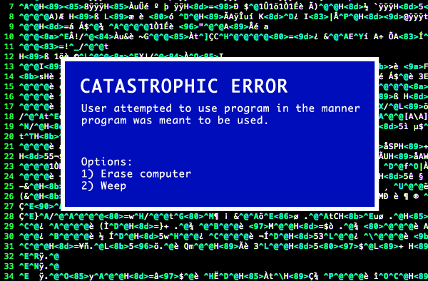
WHAT PROBLEMS DID WE EXPERIENCE?
Storing images in a MySQL database
Posting images to a MySQL database
Linking different files in the folders
Determining which user posted a bid
Crypto errors
Various bugs
Basically everything...
Notes:
Vanessa

Slide 9

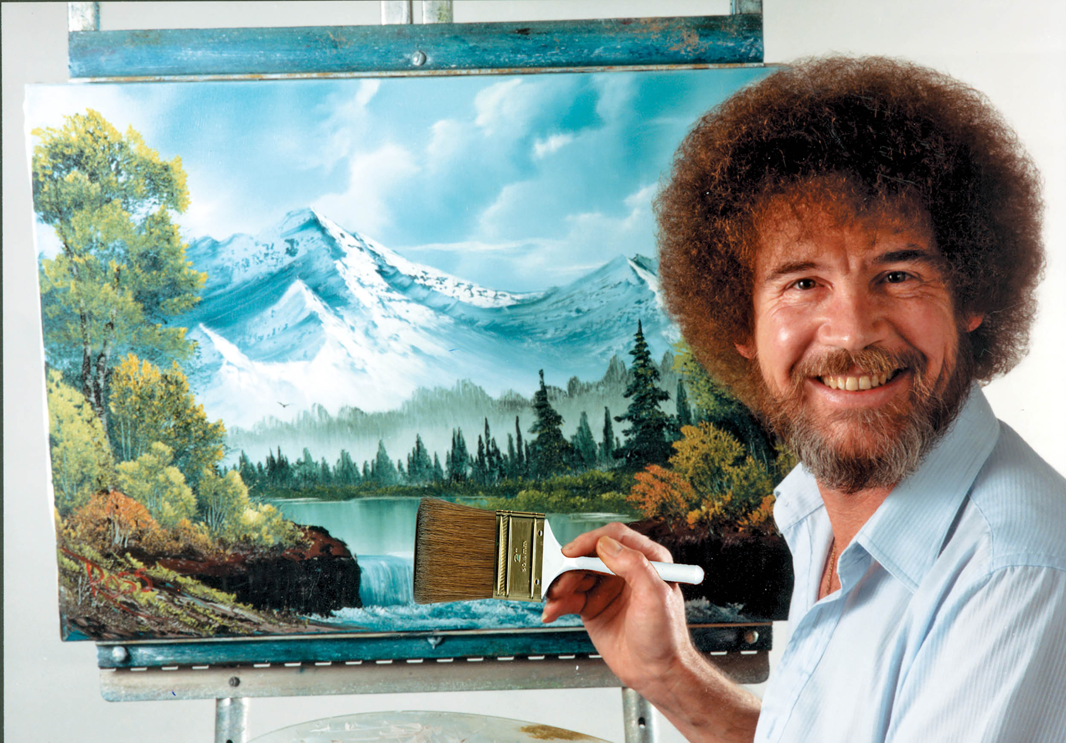

Wish List Items to Enhance BAVART
10% discount
Displaying video of Bob Ross on home page
Watermark the images being auctioned
Have the artwork be interactive
User trends
Categorize the art
Other cool things
Notes:
Vanessa

Slide 10
QUESTIONS???
https://calm-stream-84659.herokuapp.com/

